Slide 1
MSF eVoting System Online Voting User Tutorial

Slide 2
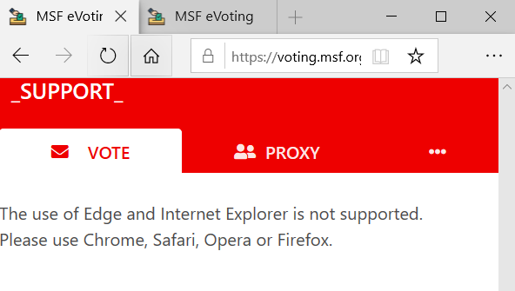
All votes made electronically are using the MSF eVoting System. Some associations enable only electronic voting, some a mix of in person and electronic.
You can use the eVoting platform from a desktop, tablet or from a smartphone.
You need access to internet to vote, use wifi or data
Browsers: Use Chrome, Mozilla Firefox, Safari, Opera. Do not use Internet Explorer or Edge
https://voting.msf.org

Slide 3
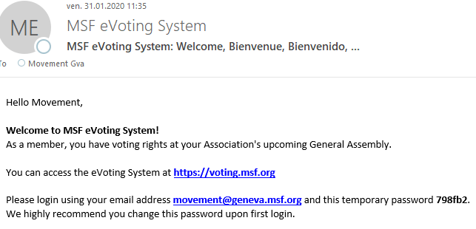
Your registration on the platform:
If you have never used the platform before you will be informed by email that an account has been created for you.
Check your inbox for an email coming from MSF eVoting System: MSF.voting@geneva.msf.org
In some rare cases, this email may have ended in your SPAM / junk folder - check it! If you find it there, do add @geneva.msf.org to your safe sender for proper reception in the future.
If you have used the MSF eVoting platform previously, you will not receive that email, but you will get an invitation to vote and the reminders to do so. If you cannot remember your password, no worries: you can reset it on the login page! (see further)

Slide 4
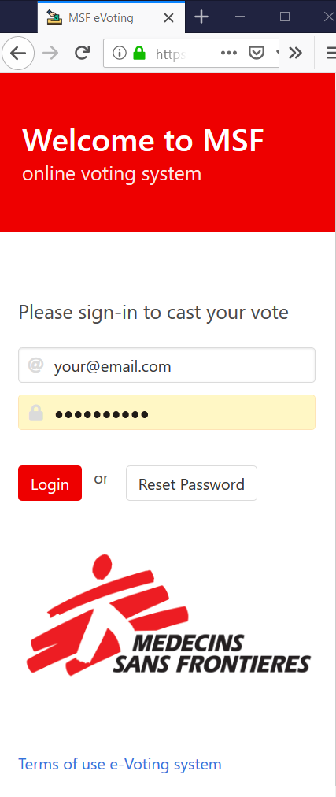
Logging in
Go to https://voting.msf.org
Enter the email address you have been invited on (which is the email you usually are receiving the emails from your association coordinator)
Enter your password – the one you received from MSF.voting@geneva.msf.org or that you have set yourself
Login

Slide 5
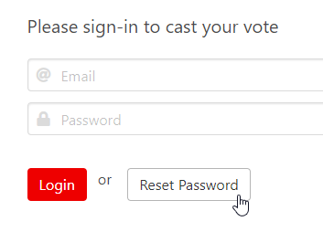
Forgot your password?
Hit “reset password” on the landing page of the platform
Enter the same email address you have received the invitation to the event (the same as your association uses to communicate to you)

Slide 6
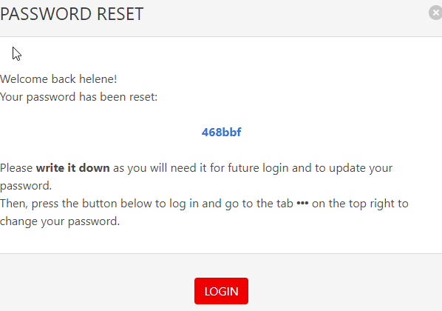
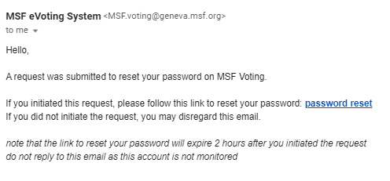
You will get an email with a link to access the platform and reset your password – do so immediately and within 2 hours
When you click on “password reset” in the email, you will be directed to the platform and a pop up will open. Copy or write down the new password (in blue) on a piece of paper so you can change it on the platform once logging in!
When you hit “login” you will be connected on the platform. Please change your password - see below how to do it.

Slide 7
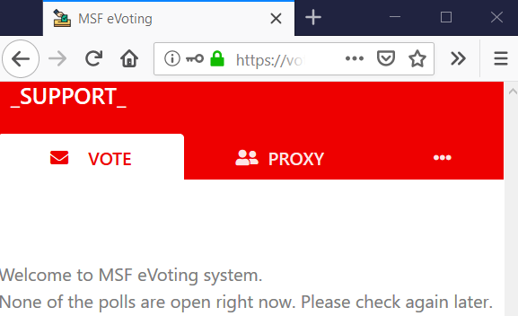
Once you are in the system, you will see this:
If your association enables proxy voting at the event, and if you will not be able to follow the event and would like to give a proxy to another voting member, you need to do so within the MSF eVoting System, here.
Your Name appears here
You can easily change your password by clicking on the
If no poll is currently open, you will see this message until it is time to vote.
https://voting.msf.org

Slide 8
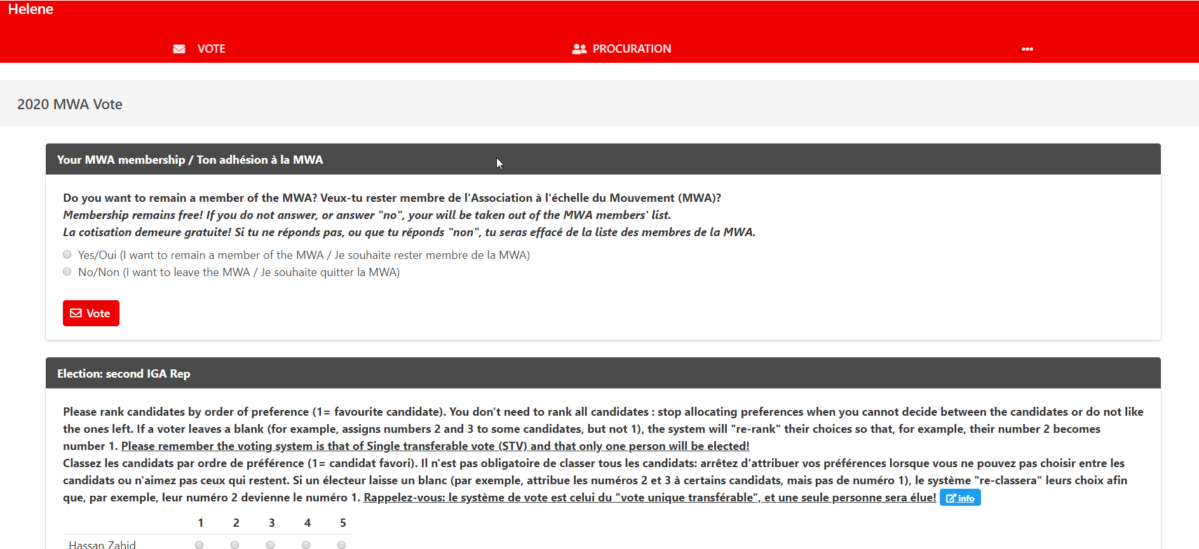
Once on the platform, you can vote. Each of the vote will appear once they are open. If nothing shows, either the votes have not opened yet, or you already casted your vote, or the votes have closed. Note that once you click "vote" you cannot change your vote any more!!

Slide 9
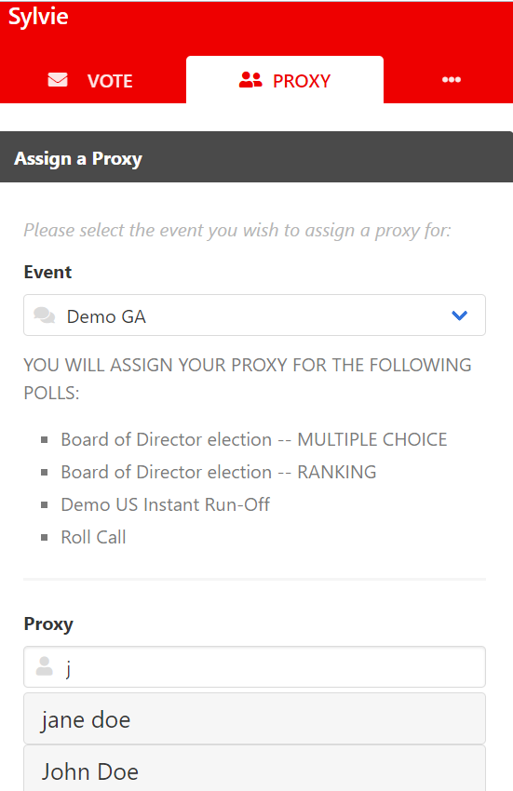
Proxy voting
To assign a proxy to another member of your association, you need to first connect to the MSF eVoting System as you will assign the proxy within the system
Go on the second tab: “proxy”
Select the event you wish to delegate your voting rights to your proxy
In the Proxy field, type the first letter(s) of the name of the person you wish to assign as your proxy.
You can also enter a ‘space’ and have a look at the other members invited to the event who have not yet reached the maximum number of proxies.
Make sure that you first check with the person if they are willing to vote on your behalf, then select them in the system. You will now see each open poll to vote for yourself, as well as for your proxy.
Should your proxy decide to vote themselves online after all, the first person among you casting the vote will have their vote registered. The system will not make it possible for both of you to vote on the same poll.

Slide 10
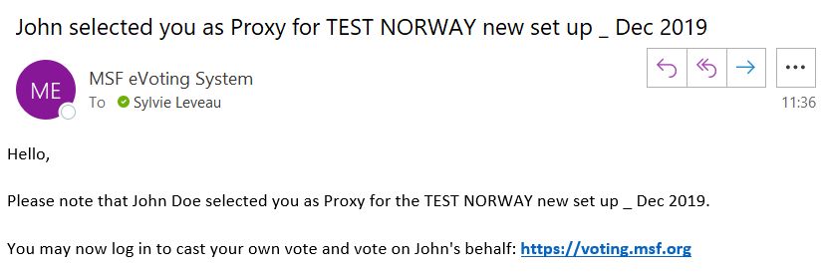
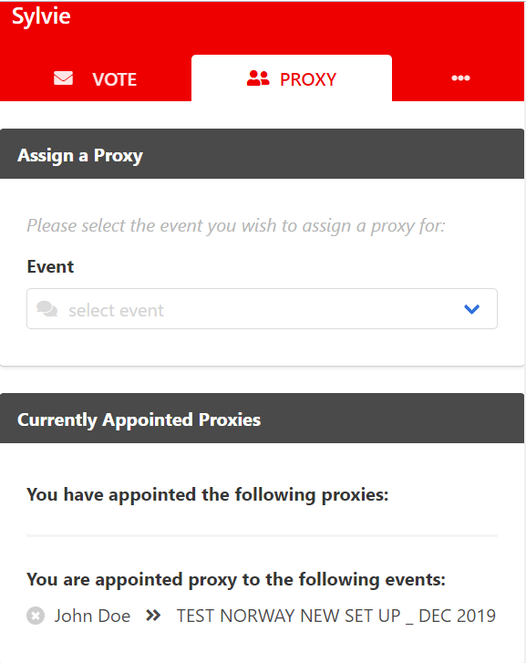
Proxy holder view
If someone designated you as a proxy, you will receive an email from the voting system informing you about it.
If you cannot be a proxy holder for this person, in the eVoting system, go to the Proxy tab and click on the cross icon next to the name of the person you don’t want to be the proxy of.

Slide 11
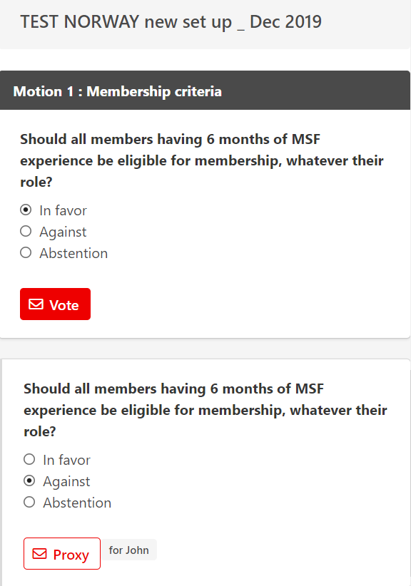
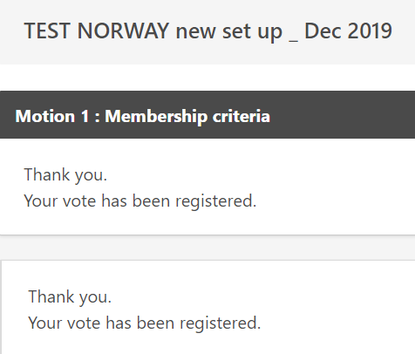
Voting for proxy
On the main vote tab in the system, you will then see the votes for yourself (button “vote” in red) as well as the vote for your Proxy, showing for who you will be voting.
You can vote for several proxy in the platform, the limit being set by your association.
Vote view
View of a vote that you have already voted on for yourself and for your proxy:

Slide 12
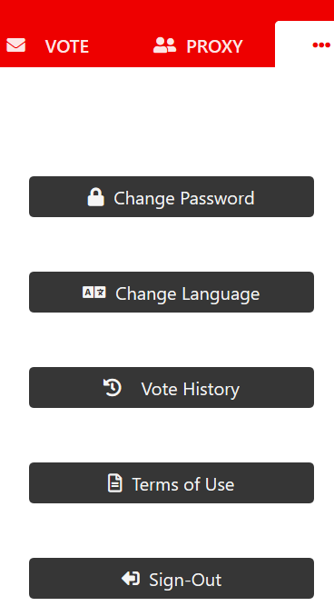
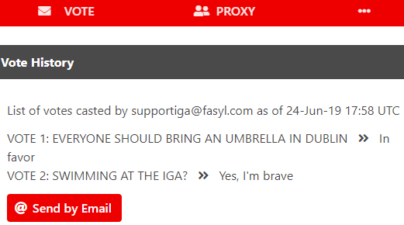
Menu
You can easily change your password to access the system here
You can retrieve the selection you made at previous polls here
And even get your vote history sent to you by email
https://voting.msf.org

